Slide 1

Aman Prasad (Product Owner)
Cody Hartsook
Harshitha Arul Murugan
Kailas Krivanka
Surya Suresh
12/2/2019
HitchHike
Team Uplyft

Slide 2
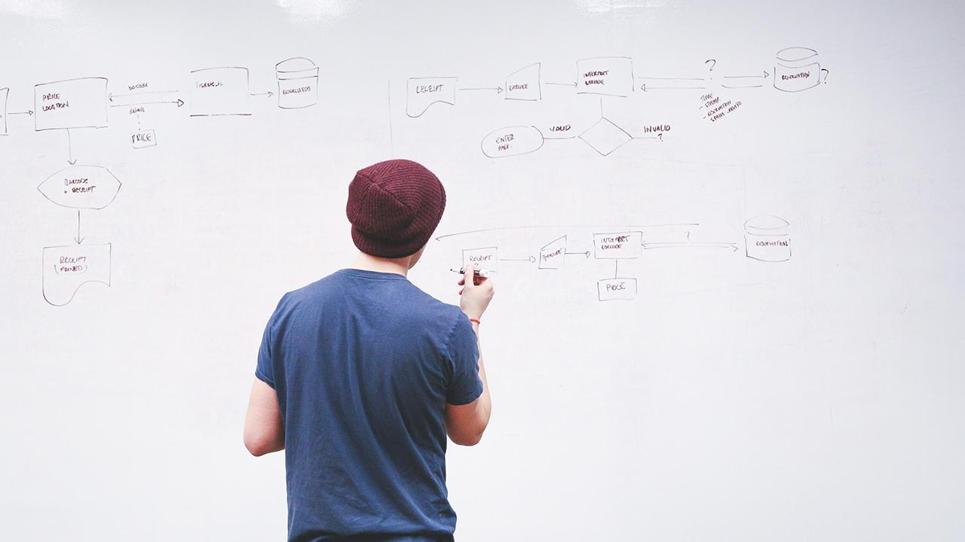
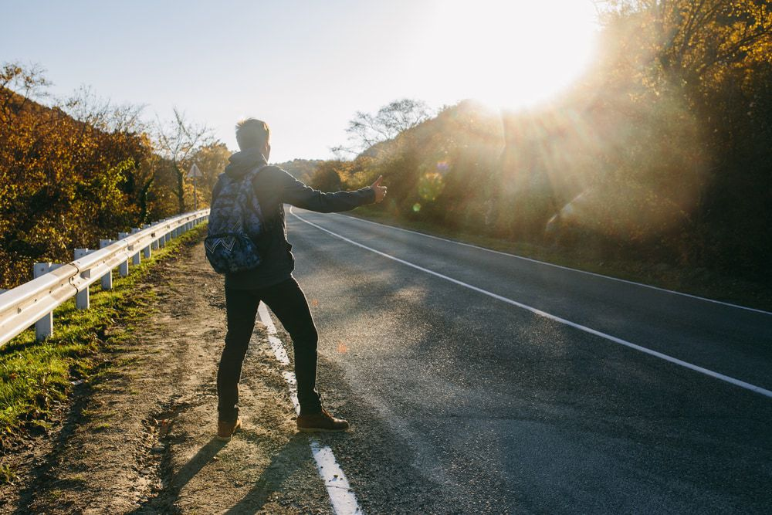
Description & Back Story
“By Students
For Students”
HitchHike is a simple app that allows students to easily arrange carpools and get where they need to go.
Originally envisioned as a form of virtual hitchhiking it has grown into a fully fledged user controlled ridesharing app.
Notes:
Kailas: Brief introduction into problem/application domain – What motivated your choice of project – Discuss intended users, problem or opportunity addressed

Slide 3
High Level Goals
Drivers sign up with .edu email addresses to post rides.
Allow riders to search and view available rides.
Allow riders to sign up for rides.
Capacity of car is not exceeded.
Drivers and riders can be rated.
Notes:
Harshitha
Goals you – set out to achieve – have achieved

Slide 4
Challenges
Accomplishments
Learning a lot of new technologies such as React Native, Express, and Node
Installing React & Node took up an entire sprint
Integration
Issues with Expo
Running the app on Android due to React Native issues
Finishing our sprints on time
Created an app with little to no react native/node experience
Learned many new concepts and terms such as agile development
Designing and implementing a custom database from scratch
Experience working in a group setting, simulating industry environment
Notes:
Surya
Biggest challenges and/or accomplishments
– Regarding your final product
– Regarding your development process

Slide 5
System Screenshots / Video
Notes:
Cody

Slide 6
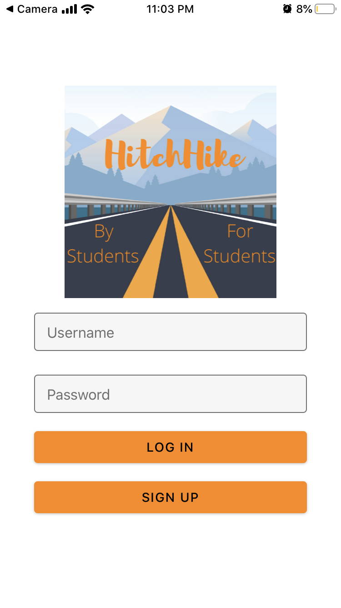
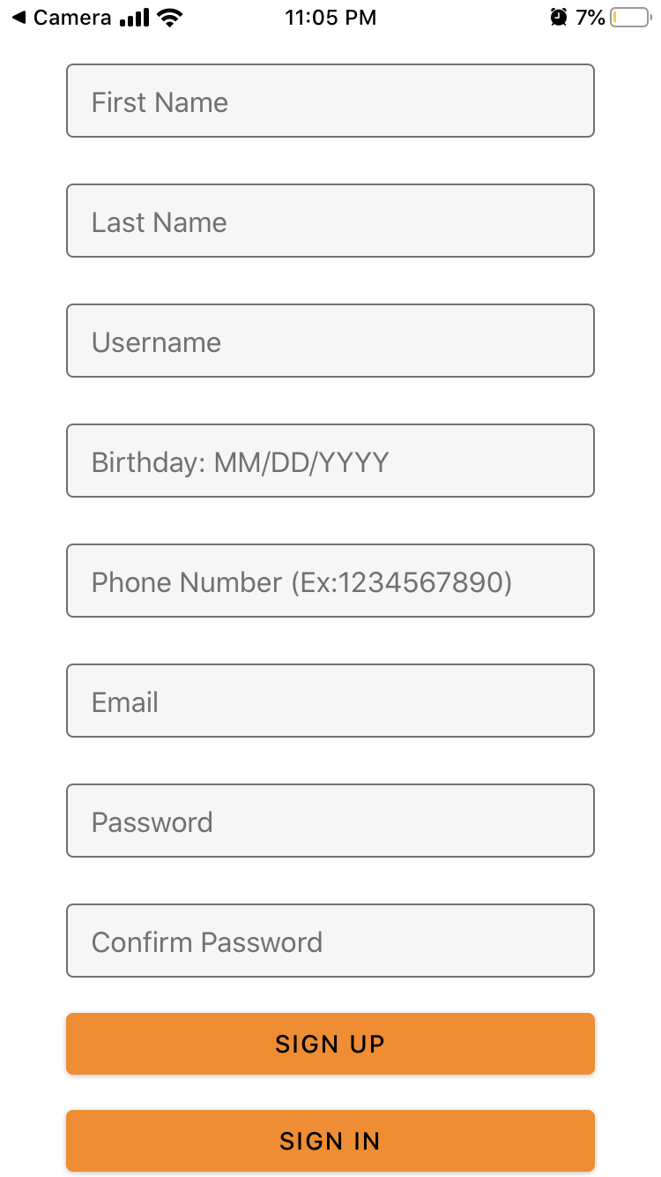
Login & Signup

Slide 7
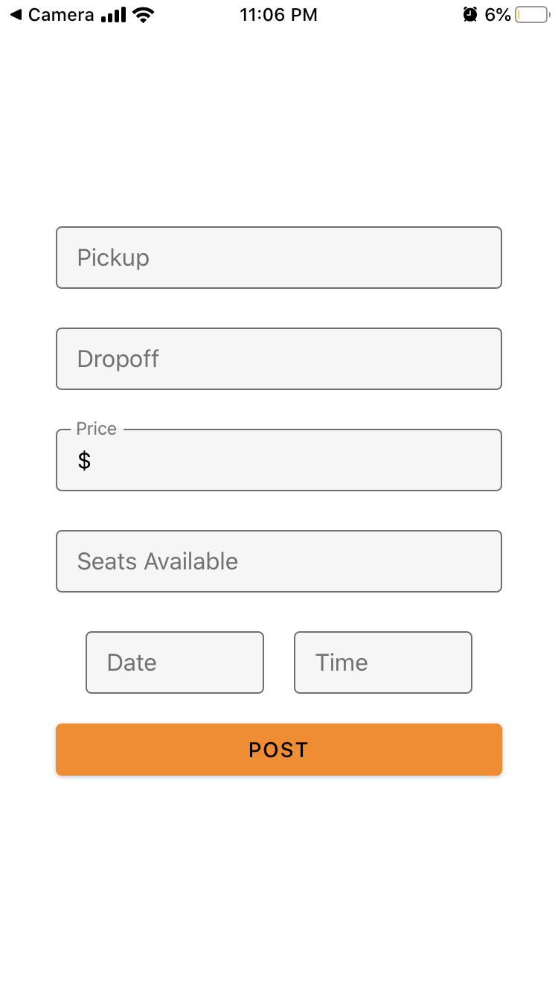
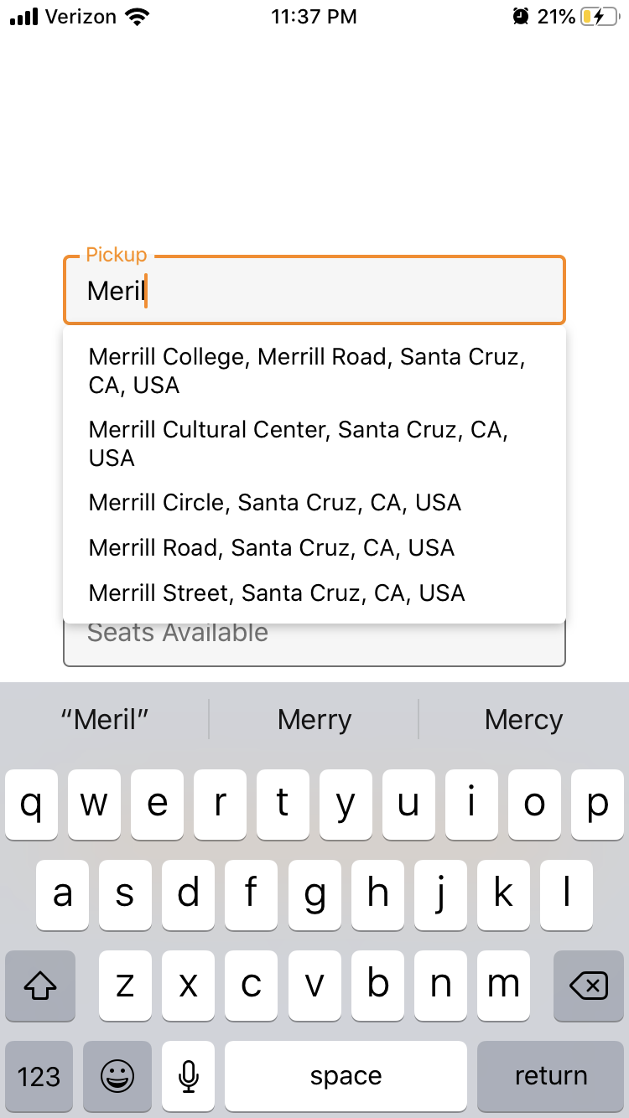
Post Ride

Slide 8
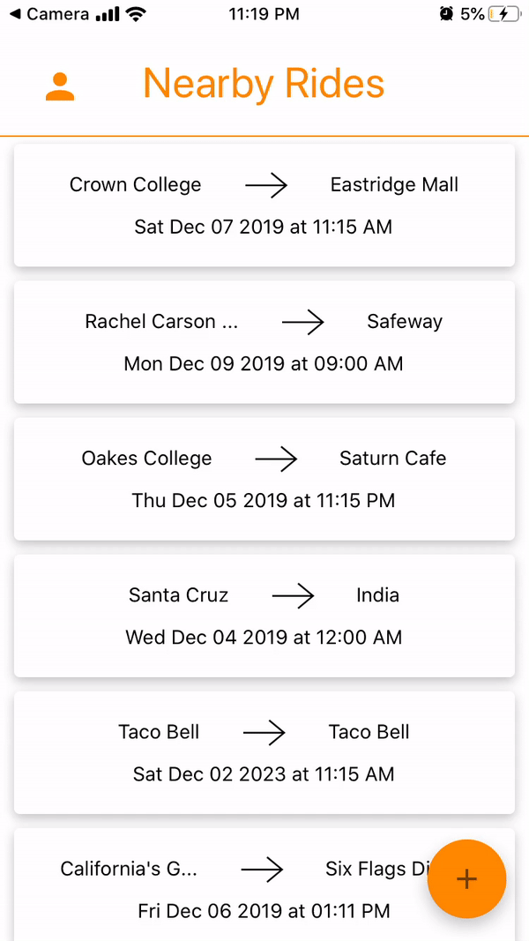
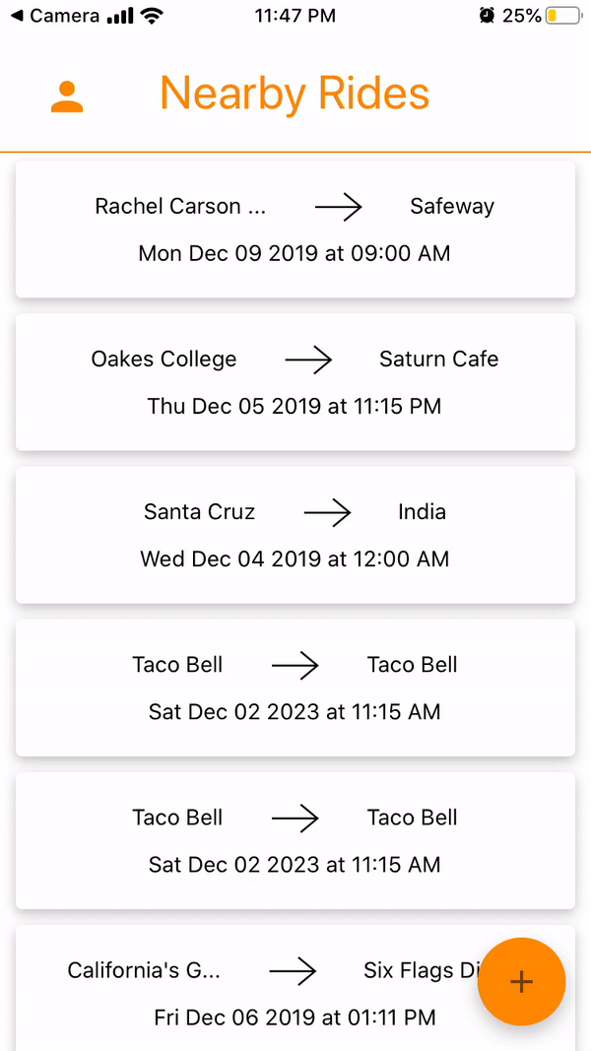
View Rides

Slide 9
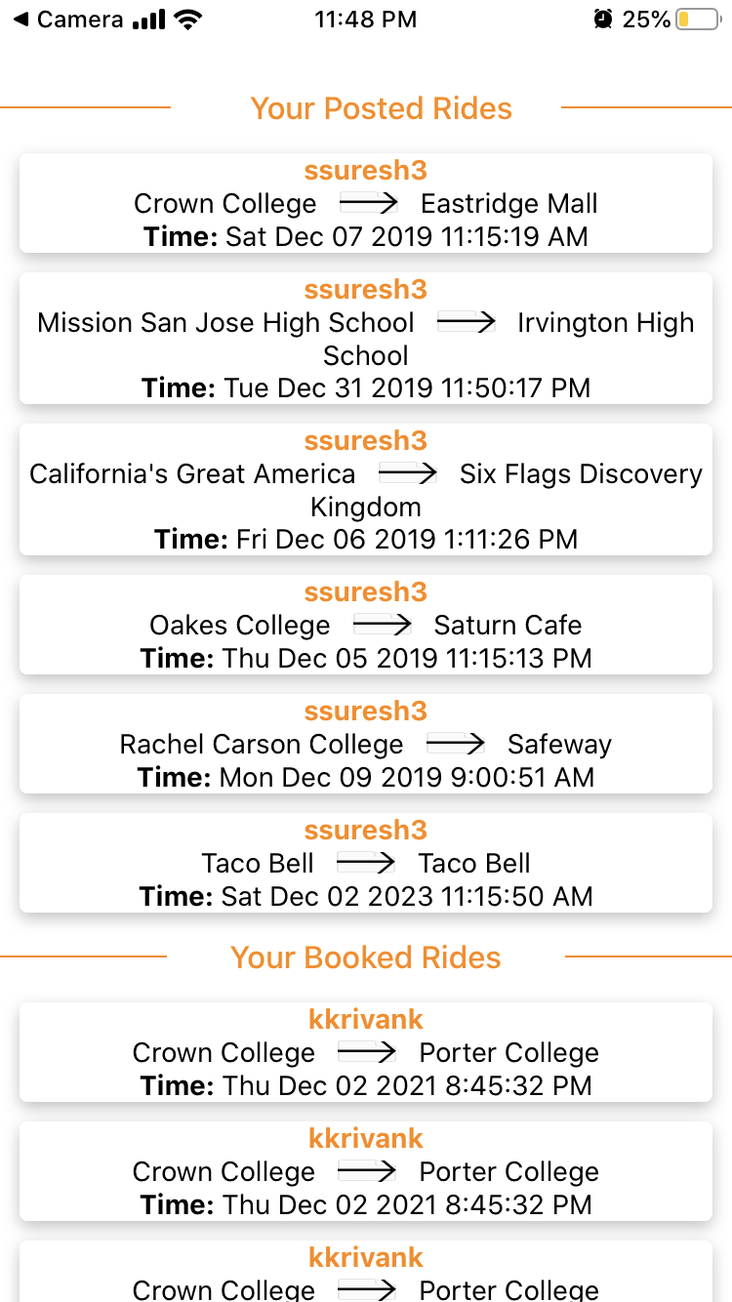
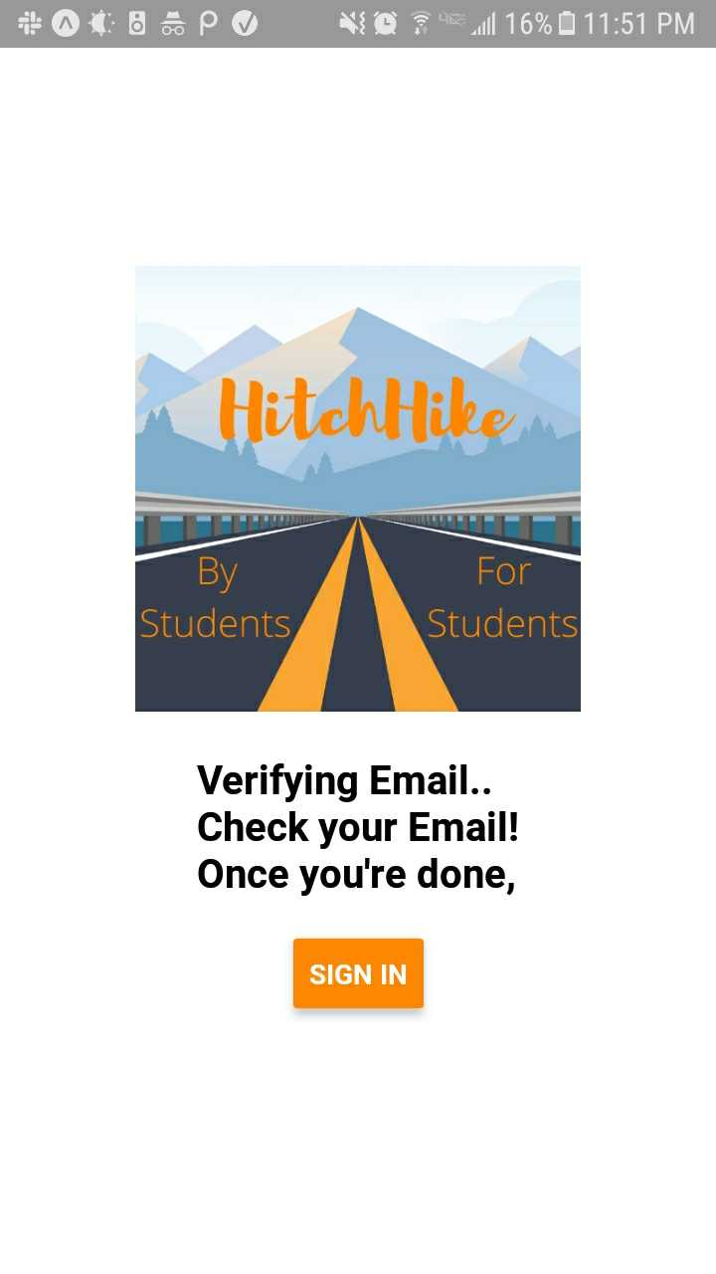
My Rides & Verification Confirmation

Slide 10
‹#›
System Overview
Front End
Server
Back End
User interacts with the app interface and provides us with data, including log-in details, contact information, rider/driver status. Users can also make requests by either posting rides as drivers or signing up for time slots as riders.
We are using an EC2 instance to handle HTTP requests. Anytime the user requests to access information, for example, available drivers, the request will be relayed through our server to the backend.
We are using json text files to store user input from our app. We will extrapolate from this data and update our user profiles, ridesharing posts, and sign-up confirmation.
Notes:
Surya
System overview/diagram – Architecture diagram and/or screen flow (whichever is most helpful in understanding your app)

Slide 11
Technologies Used
Frontend
React Native
Backend
Node.js
(custom database)
Express.js
SendGrid
HTML
Testing
Jest
Jenkins CI Pipeline
Expo
Postman
Notes:
Aman:
Use your system diagram to associate components with technologies – Please, no technology logo soup!

Slide 12
Project Management Techniques Used
Scrum
Burnup charts
Version control
Definition of “done”, Style guide
Agile
Kanban board
Notes:
Aman:
Project management techniques you used
– Especially any deviations or additions to the Scrum framework

Slide 13
Likes
Dislikes
Working in a collaborative environment when usually collaboration = cheating
Good industry experience in an academic setting
Most disciplined project we have worked on
Time crunch for completing the project
React Native development issues
Lack of prior knowledge for the technologies that we used
Notes:
Harshitha

Slide 14
Lessons Learned
We all should have installed the technologies we needed instead of finding a work around.
Communicate with your team more efficiently, integration will be easier
Frontend tasks take a lot longer than expected
Different screen sizes really affect the styling
Testing is a lot easier on the backend
Notes:
Kailas:
– what worked/what you will keep doing
– what didn’t work/what you will stop doing
– things you wished you had done (that you would start doing in the future)

Slide 15
‹#›
THANKS!
Any questions?

Slide 16
Quotations are commonly printed as a means of inspiration and to invoke philosophical thoughts from the reader.

Slide 17
BIG CONCEPT
Bring the attention of your audience over a key concept using icons or illustrations

Slide 18
You can also split your content
Is the color of milk and fresh snow, the color produced by the combination of all the colors of the visible spectrum.
Black
Is the color of coal, ebony, and of outer space. It is the darkest color, the result of the absence of or complete absorption of light.

Slide 19
In two or three columns
Yellow
Is the color of gold, butter and ripe lemons. In the spectrum of visible light, yellow is found between green and orange.
Blue
Is the colour of the clear sky and the deep sea. It is located between violet and green on the optical spectrum.
Red
Is the color of blood, and because of this it has historically been associated with sacrifice, danger and courage.

Slide 20
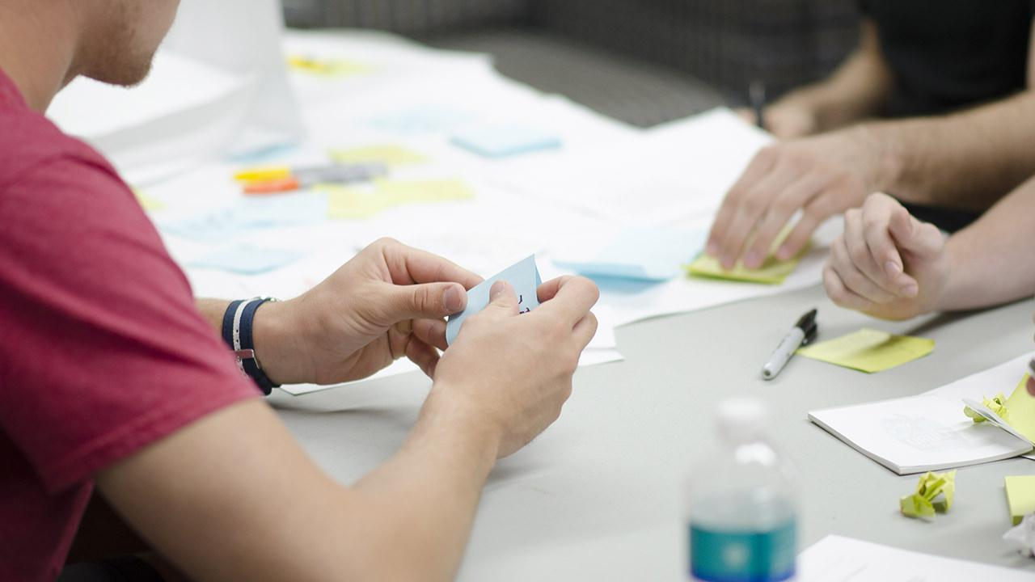
A picture is worth a thousand words
A complex idea can be conveyed with just a single still image, namely making it possible to absorb large amounts of data quickly.

Slide 21

Want big impact? USE BIG IMAGE

Slide 22
Use charts to explain your ideas
White
Gray
Black

Slide 23
And tables to compare data
 | A | B | C
Yellow | 10 | 20 | 7
Blue | 30 | 15 | 10
Orange | 5 | 24 | 16

Slide 24
Maps
our office

Slide 25
89,526,124
Whoa! That’s a big number, aren’t you proud?

Slide 26
89,526,124$
185,244 users
100%
That’s a lot of money
And a lot of users
Total success!

Slide 27
Our process is easy
first
second
last

Slide 28
Let’s review some concepts
Yellow
Is the color of gold, butter and ripe lemons. In the spectrum of visible light, yellow is found between green and orange.
Blue
Is the colour of the clear sky and the deep sea. It is located between violet and green on the optical spectrum.
Red
Is the color of blood, and because of this it has historically been associated with sacrifice, danger and courage.
Yellow
Is the color of gold, butter and ripe lemons. In the spectrum of visible light, yellow is found between green and orange.
Blue
Is the colour of the clear sky and the deep sea. It is located between violet and green on the optical spectrum.
Red
Is the color of blood, and because of this it has historically been associated with sacrifice, danger and courage.

Slide 29
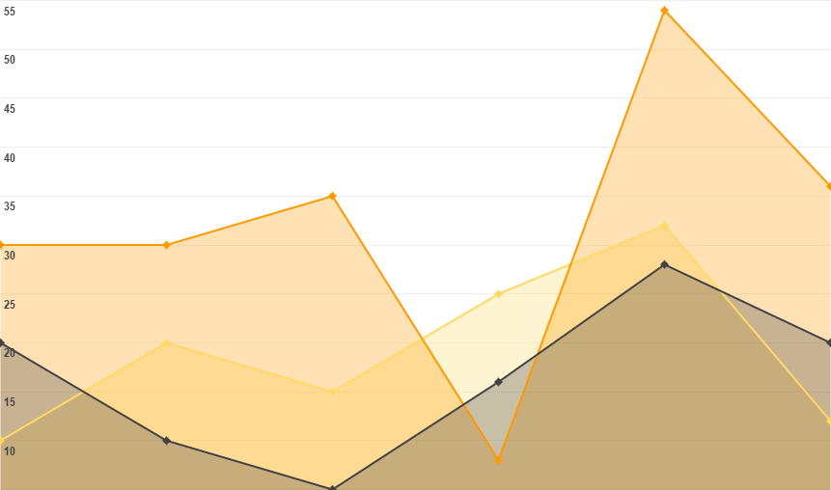
You can insert graphs from Google Sheets

Slide 30
ANDROID PROJECT
Show and explain your web, app or software projects using these gadget templates.
Place your screenshot here

Slide 31
iPHONE
PROJECT
Show and explain your web, app or software projects using these gadget templates.
Place your screenshot here

Slide 32
TABLET
PROJECT
Show and explain your web, app or software projects using these gadget templates.
Place your screenshot here

Slide 33
DESKTOP PROJECT
Show and explain your web, app or software projects using these gadget templates.
Place your screenshot here

Slide 34
Credits
Special thanks to all the people who made and released these awesome resources for free:
Presentation template by SlidesCarnival
Photographs by Startupstockphotos

Slide 35
Presentation design
This presentation uses the following typographies and colors:
Titles: Dosis
Body copy: Roboto
You can download the fonts on these pages:
https://www.fontsquirrel.com/fonts/dosis
https://material.google.com/resources/roboto-noto-fonts.html
Orange #ff8700
You don’t need to keep this slide in your presentation. It’s only here to serve you as a design guide if you need to create new slides or download the fonts to edit the presentation in PowerPoint®

Slide 36
SlidesCarnival icons are editable shapes.
This means that you can:
Resize them without losing quality.
Change line color, width and style.
Isn’t that nice? :)
Examples:

Slide 37
😉
Now you can use any emoji as an icon!
And of course it resizes without losing quality and you can change the color.
How? Follow Google instructions https://twitter.com/googledocs/status/730087240156643328
✋👆👉👍👤👦👧👨👩👪💃🏃💑❤😂😉😋😒😭👶😸🐟🍒🍔💣📌📖🔨🎃🎈🎨🏈🏰🌏🔌🔑 and many more...

Slide 38

Free templates for all your presentation needs
For PowerPoint and Google Slides
100% free for personal or commercial use
Ready to use, professional and customizable
Blow your audience away with attractive visuals

